Slide 1
Convolutional Neural Network
Advanced AI lecture

Slide 2
Summary
I/ Introduction to computer vision
II/ Convolution & pooling layer
III/ Example of CNN architectures
IV/ Residual network & inception concept
V/ Transfer learning
VI/ Object detection

Slide 3
I/ Introduction to computer vision
I/ Introduction to computer vision
II/ Convolution & pooling layer
III/ Example of CNN architectures
IV/ Residual network & inception concept
V/ Transfer learning

Slide 4

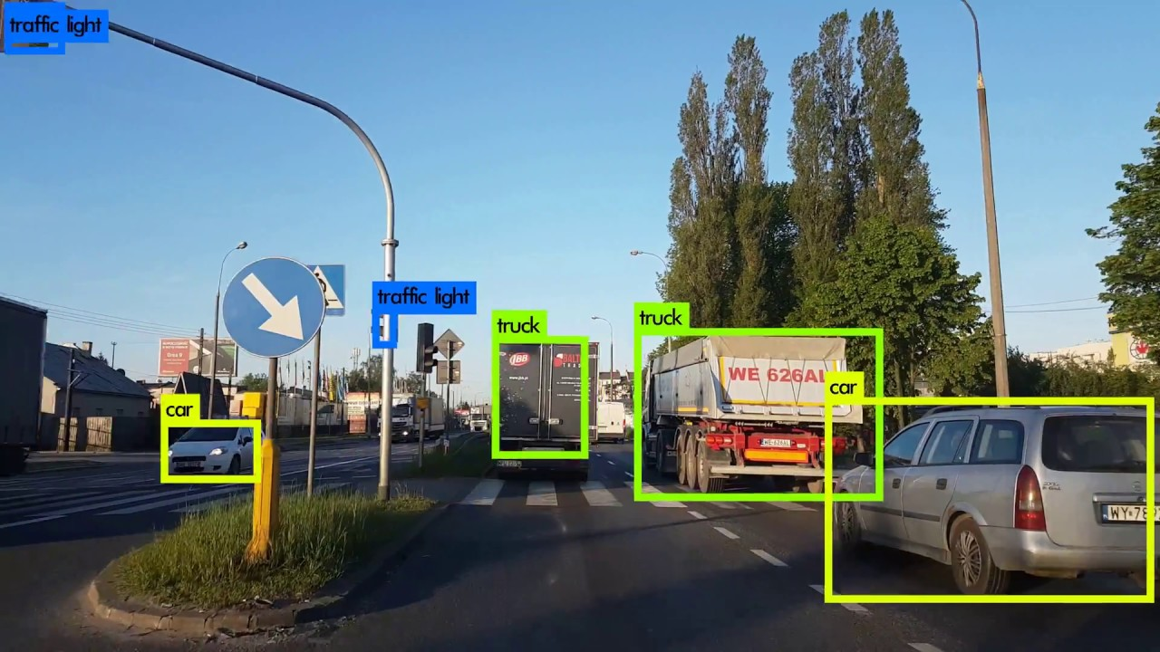
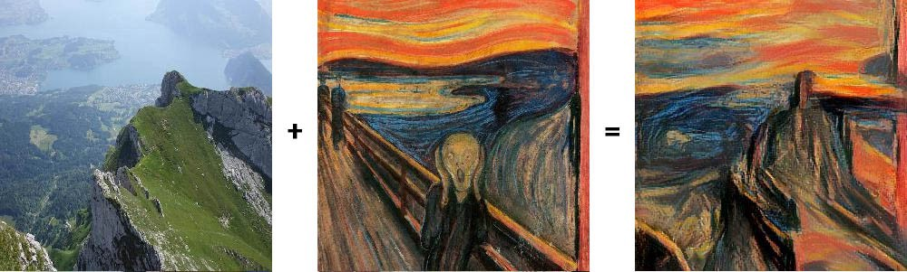
Computer vision
Image Classification
Object detection
Cat ? (0/1)
Neural Style Transfer

Slide 5
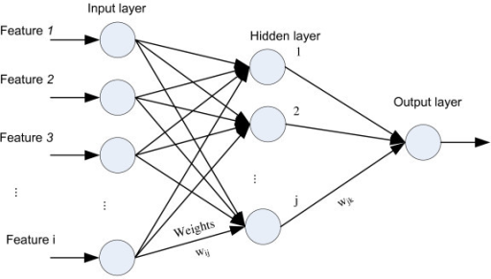
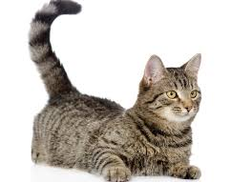

Number of features in computer vision
1 000 layers
64 x 64 x 3
12288 features
64 x 64
1000 x 1000 x 3
3 millions features
1000 x 1000

Slide 6
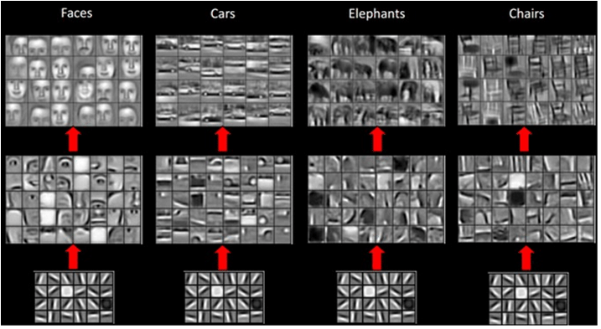
Features extraction

Slide 7
II/ Convolution & pooling layer
I/ Introduction to computer vision
II/ Convolution & pooling layer
III/ Example of CNN architectures
IV/ Residual network & inception concept
V/ Transfer learning

Slide 8
Convolutional operation
Convolution
3 | 0 | 1 | 2 | 7 | 4
1 | 5 | 8 | 9 | 3 | 1
2 | 7 | 2 | 5 | 1 | 3
0 | 1 | 3 | 1 | 7 | 8
4 | 2 | 1 | 6 | 2 | 8
2 | 4 | 5 | 2 | 3 | 9
-5
-4
0
8
1 | 0 | -1
1 | 0 | -1
1 | 0 | -1
*
=
-10
-2
2
3
0
-2
-4
-7
-3
-2
-3
-16
(3, 3)
(4, 4)
filter
(6, 6)

Slide 9
Padding
3 | 0 | 1 | 2 | 7 | 4
1 | 5 | 8 | 9 | 3 | 1
2 | 7 | 2 | 5 | 1 | 3
0 | 1 | 3 | 1 | 7 | 8
4 | 2 | 1 | 6 | 2 | 8
2 | 4 | 5 | 2 | 3 | 9
filter
*
=
(3, 3)
(4, 4)
(f, f)
(6, 6)
(n – f + 1, n – f + 1)
(n, n)

Slide 10
Padding
 | 3 | 0 | 1 | 2 | 7 | 4
 | 1 | 5 | 8 | 9 | 3 | 1
 | 2 | 7 | 2 | 5 | 1 | 3
 | 0 | 1 | 3 | 1 | 7 | 8
 | 4 | 2 | 1 | 6 | 2 | 8
 | 2 | 4 | 5 | 2 | 3 | 9
Padding
p = 1
filter
*
=
(3, 3)
(f, f)
(6, 6)
(6, 6)
(8, 8)
(n + 2p, n + 2p)
(n + 2p – f + 1, n + 2p – f + 1)
(n, n)

Slide 11




Receptive field after N convolutional layers
1x9
1x7
Receptive field
1x5
1x3
Inputs
If we stack N convolutional layers with the same kernel size 3x3 receptive field
on the N-th layer will be
It looks like we need to stack lot of layers!!

Slide 12
Convolutions on RGB images
2 | 3 | 7 | 4 | 6 | 2
6 | 6 | 9 | 8 | 7 | 4
3 | 4 | 8 | 3 | 8 | 9
7 | 8 | 3 | 6 | 6 | 3
4 | 2 | 1 | 8 | 3 | 4
3 | 2 | 4 | 1 | 9 | 8
4 | 3 | 7 | 4 | 6 | 2
è6 | 6 | 9 | 8 | 7 | 4
3 | 4 | 8 | 3 | 8 | 9
7 | 8 | 3 | 6 | 6 | 3
4 | 2 | 1 | 8 | 3 | 4
3 | 2 | 4 | 1 | 9 | 8
3 | 7 | 4 | 6 | 2 | 9
6 | 9 | 8 | 7 | 4 | 3
4 | 8 | 3 | 8 | 9 | 7
8 | 3 | 6 | 6 | 3 | 4
2 | 1 | 8 | 3 | 4 | 6
2 | 4 | 1 | 9 | 8 | 3
=
*
(3, 3, 3)
(4, 4, 1)
height
# channels
width
(7, 7, 3)
height
# channels
width

Slide 13
Convolutions on RGB images
2 | 3 | 7 | 4 | 6 | 2
6 | 6 | 9 | 8 | 7 | 4
3 | 4 | 8 | 3 | 8 | 9
7 | 8 | 3 | 6 | 6 | 3
4 | 2 | 1 | 8 | 3 | 4
3 | 2 | 4 | 1 | 9 | 8
4 | 3 | 7 | 4 | 6 | 2
è6 | 6 | 9 | 8 | 7 | 4
3 | 4 | 8 | 3 | 8 | 9
7 | 8 | 3 | 6 | 6 | 3
4 | 2 | 1 | 8 | 3 | 4
3 | 2 | 4 | 1 | 9 | 8
3 | 7 | 4 | 6 | 2 | 9
6 | 9 | 8 | 7 | 4 | 3
4 | 8 | 3 | 8 | 9 | 7
8 | 3 | 6 | 6 | 3 | 4
2 | 1 | 8 | 3 | 4 | 6
2 | 4 | 1 | 9 | 8 | 3
=
*
(3, 3, 3)
(4, 4, 1)
height
# channels
width
(7, 7, 3)
height
# channels
width

Slide 14
Convolutions on RGB images
2 | 3 | 7 | 4 | 6 | 2
6 | 6 | 9 | 8 | 7 | 4
3 | 4 | 8 | 3 | 8 | 9
7 | 8 | 3 | 6 | 6 | 3
4 | 2 | 1 | 8 | 3 | 4
3 | 2 | 4 | 1 | 9 | 8
4 | 3 | 7 | 4 | 6 | 2
è6 | 6 | 9 | 8 | 7 | 4
3 | 4 | 8 | 3 | 8 | 9
7 | 8 | 3 | 6 | 6 | 3
4 | 2 | 1 | 8 | 3 | 4
3 | 2 | 4 | 1 | 9 | 8
3 | 7 | 4 | 6 | 2 | 9
6 | 9 | 8 | 7 | 4 | 3
4 | 8 | 3 | 8 | 9 | 7
8 | 3 | 6 | 6 | 3 | 4
2 | 1 | 8 | 3 | 4 | 6
2 | 4 | 1 | 9 | 8 | 3
=
*
(3, 3, 3)
(4, 4, 1)
height
# channels
width
(6, 6, 3)
height
# channels
width

Slide 15
Convolutions on RGB images
2 | 3 | 7 | 4 | 6 | 2
6 | 6 | 9 | 8 | 7 | 4
3 | 4 | 8 | 3 | 8 | 9
7 | 8 | 3 | 6 | 6 | 3
4 | 2 | 1 | 8 | 3 | 4
3 | 2 | 4 | 1 | 9 | 8
4 | 3 | 7 | 4 | 6 | 2
è6 | 6 | 9 | 8 | 7 | 4
3 | 4 | 8 | 3 | 8 | 9
7 | 8 | 3 | 6 | 6 | 3
4 | 2 | 1 | 8 | 3 | 4
3 | 2 | 4 | 1 | 9 | 8
3 | 7 | 4 | 6 | 2 | 9
6 | 9 | 8 | 7 | 4 | 3
4 | 8 | 3 | 8 | 9 | 7
8 | 3 | 6 | 6 | 3 | 4
2 | 1 | 8 | 3 | 4 | 6
2 | 4 | 1 | 9 | 8 | 3
=
*
(3, 3, 3)
(4, 4, 1)
height
# channels
width
(6, 6, 3)
height
# channels
width

Slide 16
Multiple filters
=
*
2 | 3 | 7 | 4 | 6 | 2
6 | 6 | 9 | 8 | 7 | 4
3 | 4 | 8 | 3 | 8 | 9
7 | 8 | 3 | 6 | 6 | 3
4 | 2 | 1 | 8 | 3 | 4
3 | 2 | 4 | 1 | 9 | 8
(4, 4, 1)
4 | 3 | 7 | 4 | 6 | 2
è6 | 6 | 9 | 8 | 7 | 4
3 | 4 | 8 | 3 | 8 | 9
7 | 8 | 3 | 6 | 6 | 3
4 | 2 | 1 | 8 | 3 | 4
3 | 2 | 4 | 1 | 9 | 8
3 | 7 | 4 | 6 | 2 | 9
6 | 9 | 8 | 7 | 4 | 3
4 | 8 | 3 | 8 | 9 | 7
8 | 3 | 6 | 6 | 3 | 4
2 | 1 | 8 | 3 | 4 | 6
2 | 4 | 1 | 9 | 8 | 3
=
=
*
(4, 4, 1)
(4, 4, 3)
=
*
(6, 6, 3)
(4, 4, 1)
(3, 3, 3)

Slide 17






Examples of layers
=
relu
2 | 3 | 7 | 4 | 6 | 2
6 | 6 | 9 | 8 | 7 | 4
3 | 4 | 8 | 3 | 8 | 9
7 | 8 | 3 | 6 | 6 | 3
4 | 2 | 1 | 8 | 3 | 4
3 | 2 | 4 | 1 | 9 | 8
*
4 | 3 | 7 | 4 | 6 | 2
6 | 6 | 9 | 8 | 7 | 4
3 | 4 | 8 | 3 | 8 | 9
7 | 8 | 3 | 6 | 6 | 3
4 | 2 | 1 | 8 | 3 | 4
3 | 2 | 4 | 1 | 9 | 8
3 | 7 | 4 | 6 | 2 | 9
6 | 9 | 8 | 7 | 4 | 3
4 | 8 | 3 | 8 | 9 | 7
8 | 3 | 6 | 6 | 3 | 4
2 | 1 | 8 | 3 | 4 | 6
2 | 4 | 1 | 9 | 8 | 3
=
=
relu
*

Slide 18






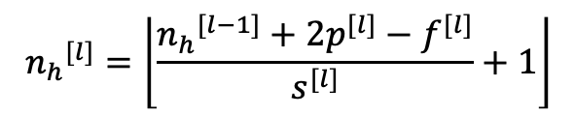
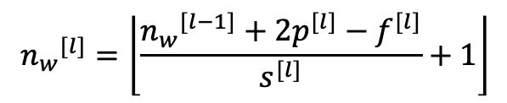



Summary of notation
If layer l is a convolutional layer :
Input:
Output:
Each filter is :
Activations:
Weights:
Bias:

Slide 19


















Example ConvNet
X
filters
(37, 37, 10)
(17, 17, 20)
(39, 39, 3)

Slide 20
How do we maintain translation invariance ?
Input
Kernel
Output
0 | 0 | 0 | 0
0 | 0 | 0 | 0
0 | 0 | 1 | 0
0 | 0 | 0 | 1
0 | 0 | 0
0 | 1 | 0
0 | 0 | 2
*
1 | 0
0 | 1
=
Max = 2
Didn’t
Change
Input
Kernel
Output
1 | 0 | 0 | 0
0 | 1 | 0 | 0
0 | 0 | 0 | 0
0 | 0 | 0 | 0
2 | 0 | 0
0 | 1 | 0
0 | 0 | 0
*
1 | 0
0 | 1
=
Max = 2

Slide 21

Pooling layer: Max pooling
2
3 | 0 | 1 | 2 | 7 | 4
1 | 5 | 8 | 9 | 3 | 1
2 | 7 | 2 | 5 | 1 | 3
0 | 1 | 3 | 1 | 7 | 8
4 | 2 | 1 | 6 | 2 | 8
2 | 4 | 5 | 2 | 3 | 9
5
9
7
7
5
8
4
6
9
Hyperparameters:
(3, 3)
(6, 6)

Slide 22

Pooling layer: Max pooling
3 | 0 | 1 | 2 | 7 | 4
1 | 5 | 8 | 9 | 3 | 1
2 | 7 | 2 | 5 | 1 | 3
0 | 1 | 3 | 1 | 7 | 8
4 | 2 | 1 | 6 | 2 | 8
2 | 4 | 5 | 2 | 3 | 9
3 | 0 | 1 | 2 | 7 | 4
1 | 5 | 8 | 9 | 3 | 1
2 | 7 | 2 | 5 | 1 | 3
0 | 1 | 3 | 1 | 7 | 8
4 | 2 | 1 | 6 | 2 | 8
2 | 4 | 5 | 2 | 3 | 9
5
9
7
5
9
7
7
5
8
7
5
8
4
6
9
4
6
9
Hyperparameters:
(3, 3, 2)
(6, 6, 2)

Slide 23

Pooling layer: Average pooling
3 | 0 | 1 | 2 | 7 | 4
1 | 5 | 8 | 9 | 3 | 1
2 | 7 | 2 | 5 | 1 | 3
0 | 1 | 3 | 1 | 7 | 8
4 | 2 | 1 | 6 | 2 | 8
2 | 4 | 5 | 2 | 3 | 9
2.25
5
3.75
2.5
2.75
4.75
3
3.5
5.5
Hyperparameters:
(3, 3)
(6, 6)

Slide 24

Pooling layer: Average pooling
3 | 0 | 1 | 2 | 7 | 4
1 | 5 | 8 | 9 | 3 | 1
2 | 7 | 2 | 5 | 1 | 3
0 | 1 | 3 | 1 | 7 | 8
4 | 2 | 1 | 6 | 2 | 8
2 | 4 | 5 | 2 | 3 | 9
3 | 0 | 1 | 2 | 7 | 4
1 | 5 | 8 | 9 | 3 | 1
2 | 7 | 2 | 5 | 1 | 3
0 | 1 | 3 | 1 | 7 | 8
4 | 2 | 1 | 6 | 2 | 8
2 | 4 | 5 | 2 | 3 | 9
5
9
7
2.25
5
3.75
7
5
8
2.5
2.75
4.75
4
6
9
3
3.5
5.5
Hyperparameters:
(3, 3, 2)
(6, 6, 2)

Slide 25
Three first block of CNN
*
=
Convolutional block
Pooling block
Fully connected block

Slide 26




Why Convolutions ?
f=5
bias
6 filters
f=5
(32, 32, 3)
6 filters
(28, 28, 6)
156 parameters
3 072
4 704
14 millions parameters
3 072
4 704

Slide 27
Why Convolutions ?
Parameter sharing: A feature detector that’s useful in one part of the image is probably in another part or the image.
Sparsity of connections: In each layer, each output value depends only on a small number of inputs.
Translation invariance: if you translate the picture it will not change anything for a convolutional neural network.

Slide 28
III/ Example of CNN achitectures
I/ Introduction to computer vision
II/ Convolution & pooling layer
III/ Example of CNN architectures
IV/ Residual network & inception concept
V/ Transfer learning

Slide 29

LeNet-5
Conv 1
Pool 1
Conv 2
Pool 2
Flatten
FC 3
FC 4
Softmax
7
(28, 28, 6)
(14, 14, 6)
(10, 10, 16)
(5, 5, 16)
400
120
84
10
f=5
f=2
f=5
f=2
s=1
s=2
s=1
s=2
Layer 1
Layer 2

Slide 30
Neural network example (LeNet-5)
 | Activation shape | Activation size | # parameters
Input: | (32, 32, 3) | 3 072 | 0
CONV1 (f=5, s=1) | (28,28, 8) | 6 272 | 208
POOL1 | (14, 14, 8) | 1 568 | 0
CONV2 (f=5, s=1) | (10, 10, 46) | 1 600 | 416
POOL2 | (5, 5, 16) | 400 | 0
FC3 | (120, 1) | 120 | 48 001
FC4 | (84, 1) | 84 | 10 081
Softmax | (10, 1) | 10 | 841

Slide 31

AlexNet
Conv 1
Pool 1
Conv 2
Pool 2
Conv 3
Conv 4
Conv 5
Pool 5
(227, 227, 3)
(55, 55, 96)
(27, 27, 96)
(27, 27, 256)
(13, 13, 256)
(13, 13, 384)
(13, 13, 384)
(13, 13, 256)
(6, 6, 256)
s=4
f=11
s=4
f=3
same
f=5
s=2
f=3
same
f=3
same
f=3
same
f=3
s=2
f=3
Flatten
FC 6
FC 7
Softmax
9216
4096
4096
1000

Slide 32
VGG-16
Conv 1 x2
Pool 1
Conv 2 x2
Pool 2
Conv 3 x3
Pool 3
Conv 4 x3
(224, 224, 3)
(224,224, 64)
(112, 112, 64)
(112, 112, 128)
(56, 56, 128)
(56, 56, 256)
(28, 28, 128)
(28,28, 512)
Pool 4
Conv 5 x3
Pool 5
Flatten
FC 6
FC 7
Softmax
Max-pool
Filter = (2, 2)
Stride = 2
Padding = same
Conv
Filter = (3, 3)
Stride = 1
(14, 14, 512)
(14, 14, 512)
(7, 7, 512)
25 088
4 096
4 096
1 000

Slide 33
IV/ Residual network & inception concept
I/ Introduction to computer vision
II/ Convolution & pooling layer
III/ Example of CNN architectures
IV/ Residual network & inception concept
V/ Transfer learning

Slide 34








Residual block
“shortcut”
“main path”

Slide 35
Why does a 1x1 convolution do?
3 | 0 | 1 | 2 | 7 | 4
1 | 5 | 8 | 9 | 3 | 1
2 | 7 | 2 | 5 | 1 | 3
0 | 1 | 3 | 1 | 7 | 8
4 | 2 | 1 | 6 | 2 | 8
2 | 4 | 5 | 2 | 3 | 9
6 | 0 | 2 | 4 | 14 | 8
2 | 10 | 16 | 18 | 6 | 2
4 | 14 | 4 | 10 | 2 | 6
0 | 2 | 6 | 2 | 14 | 16
8 | 4 | 2 | 12 | 4 | 16
4 | 8 | 10 | 4 | 6 | 16
2
=
*

Slide 36
Why does a 1x1 convolution do?
*
=
(6, 6, 32)
(1, 1, 32)
(6, 6, #filters)
You can use 1x1 to reduce the number of filters!

Slide 37
Using 1x1 convolution
Filters = 32
*
=
(28, 28, 192)
(5, 5, 192)
(28, 28, 32)
32 x (5 x 5 x 192 +1) = 153 632 parameters

Slide 38
Using 1x1 convolution
Filters = 32
Filters = 16
*
=
*
=
(28, 28, 32)
(28, 28, 192)
(1, 1, 192)
(28, 28, 16)
(5, 5, 32)
16 x (1 x 1 x 192 + 1) = 3 088
32 x (5 x 5 x 16 +1)= 12 832
15 872 parameters

Slide 39
Inception module
Conv (1, 1)
Conv (3, 3)
Conv (5, 5)
MAX-POOL
128
64
(28, 28, 192)
32
32
(28, 28, 256)

Slide 40
V/ Tranfer learning
I/ Introduction to computer vision
II/ Convolution & pooling layer
III/ Example of CNN architectures
IV/ Residual network & inception concept
V/ Transfer learning

Slide 41
Transfer learning if you have little data
Conv 1
Pool 1
Conv 2
Pool 2
Conv 3
Conv 4
Conv 5
Pool 5
(227, 227, 3)
(55, 55, 96)
(27, 27, 96)
(27, 27, 256)
(13, 13, 256)
(13, 13, 384)
(13, 13, 384)
(13, 13, 256)
(6, 6, 256)
s=4
f=11
s=4
f=3
same
f=5
s=2
f=3
same
f=3
same
f=3
same
f=3
s=2
f=3
Flatten
FC 6
FC 7
Softmax
To adapt your model retain only the last layer
9216
4096
4096
1000

Slide 42
Transfer learning if you have some data
Conv 1
Pool 1
Conv 2
Pool 2
Conv 3
Conv 4
Conv 5
Pool 5
(227, 227, 3)
(55, 55, 96)
(27, 27, 96)
(27, 27, 256)
(13, 13, 256)
(13, 13, 384)
(13, 13, 384)
(13, 13, 256)
(6, 6, 256)
s=4
f=11
s=4
f=3
same
f=5
s=2
f=3
same
f=3
same
f=3
same
f=3
s=2
f=3
Flatten
FC 6
FC 7
Softmax
To adapt your model retain only last layers
9216
4096
4096
1000

Slide 43
Fine-tuning if you have large dataset
Conv 1
Pool 1
Conv 2
Pool 2
Conv 3
Conv 4
Conv 5
Pool 5
(227, 227, 3)
(55, 55, 96)
(27, 27, 96)
(27, 27, 256)
(13, 13, 256)
(13, 13, 384)
(13, 13, 384)
(13, 13, 256)
(6, 6, 256)
s=4
f=11
s=4
f=3
same
f=5
s=2
f=3
same
f=3
same
f=3
same
f=3
s=2
f=3
Flatten
FC 6
FC 7
Softmax
Use weights of the model as initialization
9216
4096
4096
1000

Slide 44
Takeaways
Not so similar to ImageNet
ImageNet Domain
Small dataset
Train last MLP layers
Collect more data
Fine-tunning of deeper layers
Big dataset
Train from scratch

